Slide 1
Federated Learning
in IoMT

Slide 2
Introduction:
Internet of Medical Things (IoMT) refers to the interconnected medical devices and applications that collect and share healthcare data.
While Using machine learning, Healthcare institutes face privacy concerns as they need to send personal healthcare data to a model at some other place.
So, to solve the problem of the centralized model, privacy concerns, and no security of data Federated Learning comes into action.

Slide 3
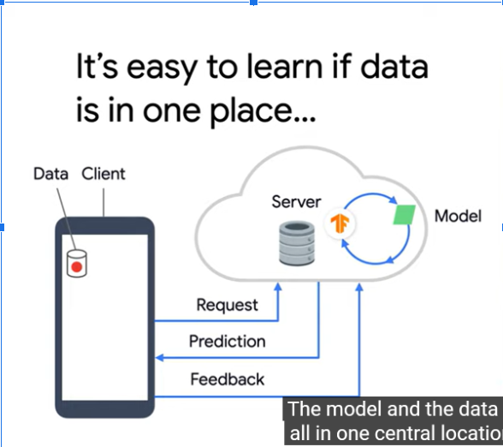
AI/ML in IoMT data:

Slide 4
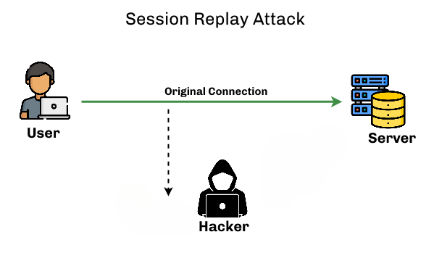

Problems using AI/ML:

Slide 5
To solve such a problem,
Federated Learning comes
into action

Slide 6
Federated Learning
Federated Learning is a decentralized machine learning approach where the model is trained across multiple edge devices without exchanging raw data.
Models are trained locally on individual devices, and only model updates (not raw data) are sent to a central server.
Raw patient data remains on local devices, reducing the risk of centralized data breaches.
Models improve over time by leveraging insights from diverse datasets without centralizing the data.

Slide 7

With Federated Learning:

Slide 8
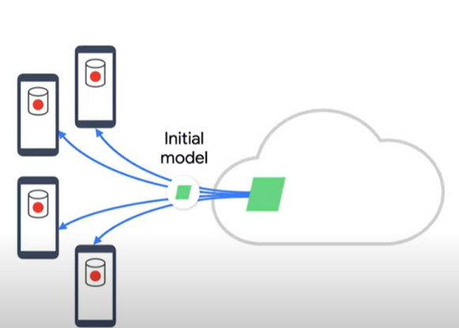
How it works?

Slide 9
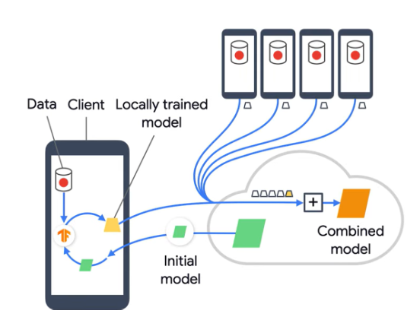
How it works?

Slide 10
But this done once can't assure a good model, thus we need to do it again and again so that the combined model becomes the initial model for the next round, and it gets better round by round.

Slide 11
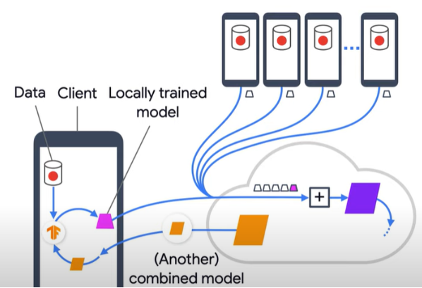
How it works?

Slide 12
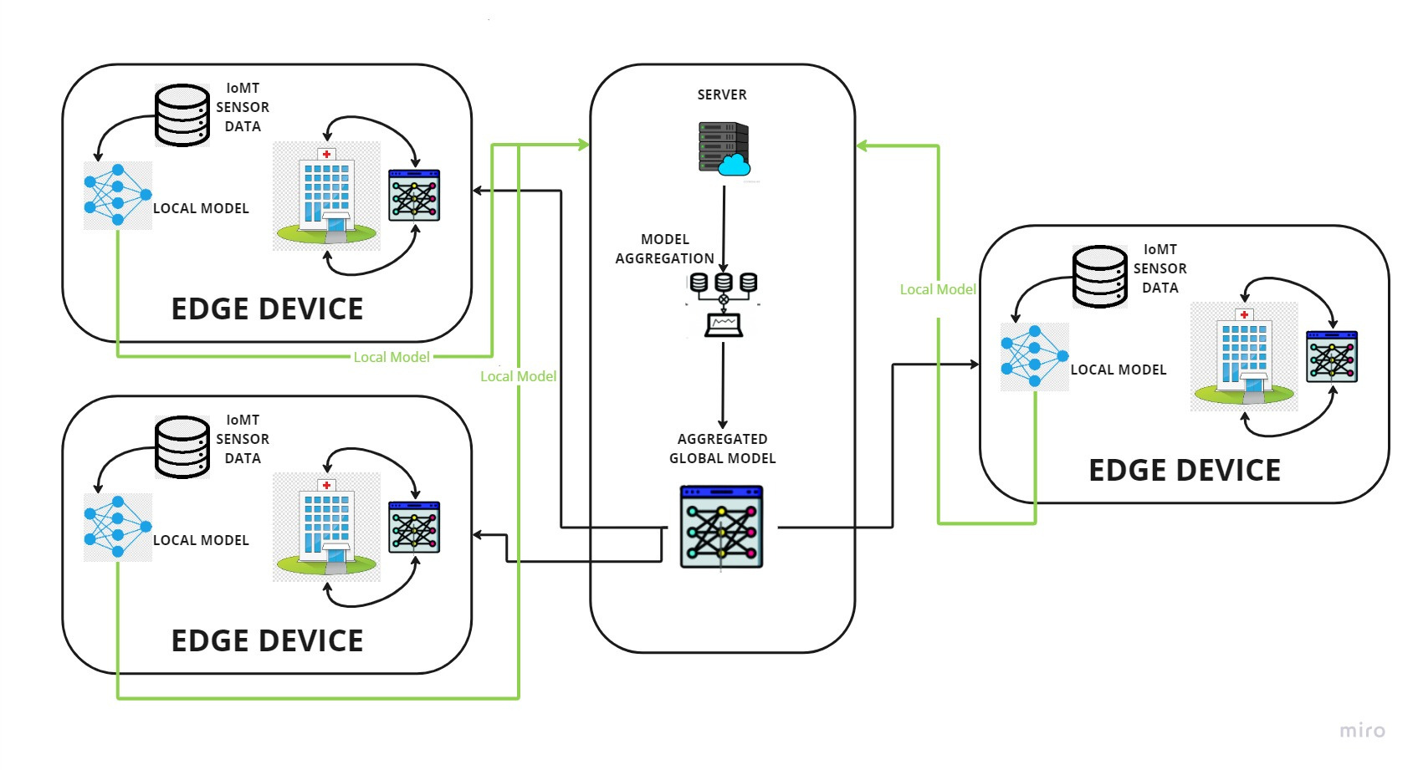
Federated Learning in IoMt System Architecture?

Slide 13
Simulation

Slide 14
Datasets
The dataset used contains images related to COVID-19 and Viral Pneumonia.
The images are loaded and processed for further analysis, including resizing to 100x100 pixels.
The datasets (covid and pnemo) are created for COVID and Viral Pneumonia images, respectively.
In total, we are taking 3616 COVID data images with 1205 Viral Pneumonia images.
The data is automatically split among the different clients based on randomness.

Slide 15
Simulation
The Python software platform called Kaggle is used to simulate the suggested federated learning model.
The features of federated averaging, local training, and client creation are implemented in a federated SVM class.
The required number of customers can be changed and adjusted according to the user.
The data is automatically split into segments for the experiment based on randomness and then sent to clients for testing, validation, and training.

Slide 16
Results

Slide 17
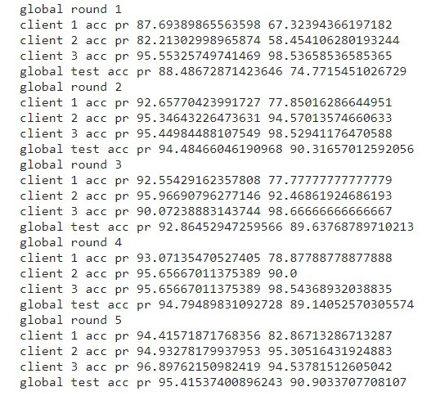
Accuracy
and
Precision
Values at
Local and
Global Level
of one
random test

Slide 18
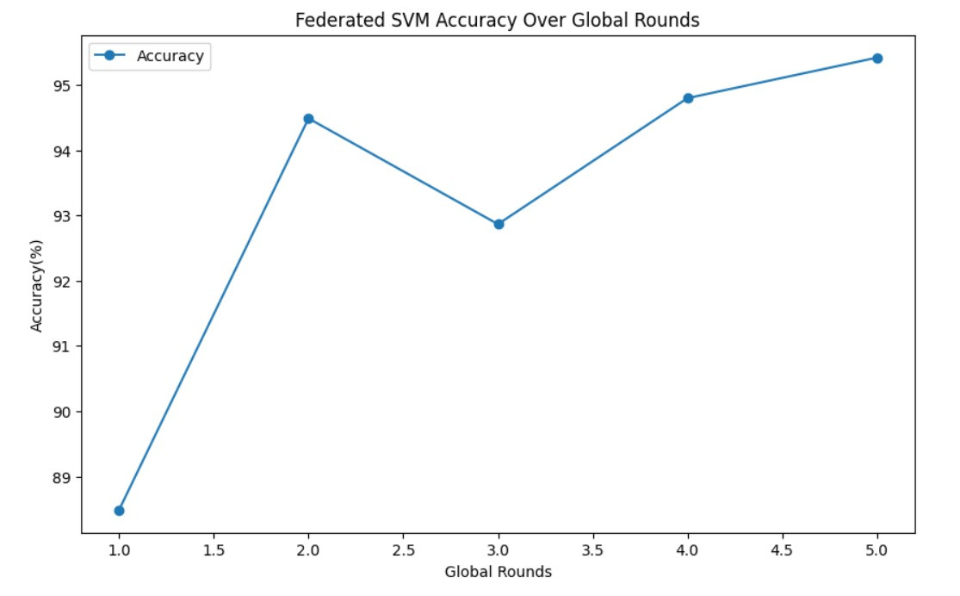
Federated SVM Accuracy

Slide 19
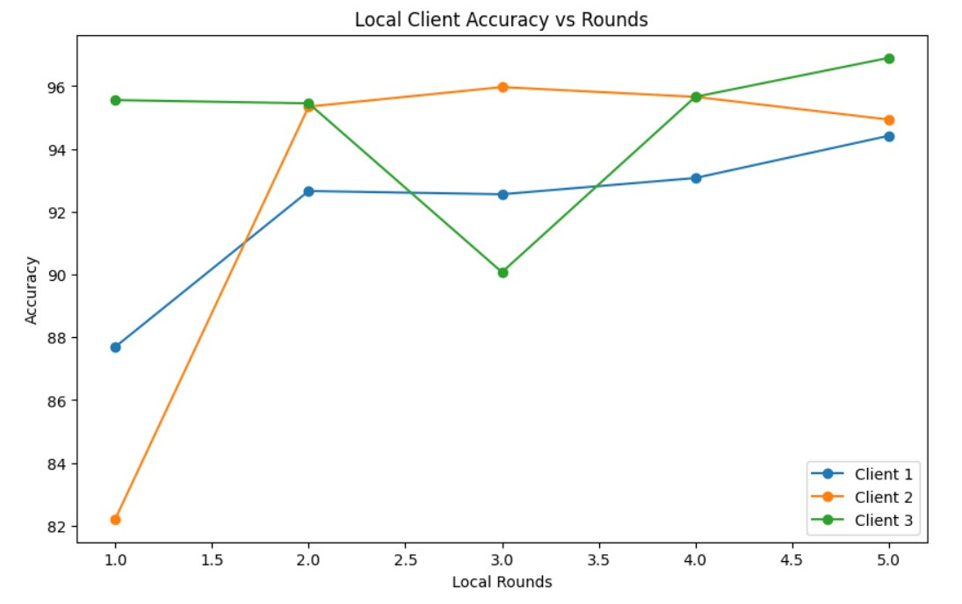
Local Client's Accuracy

Slide 20
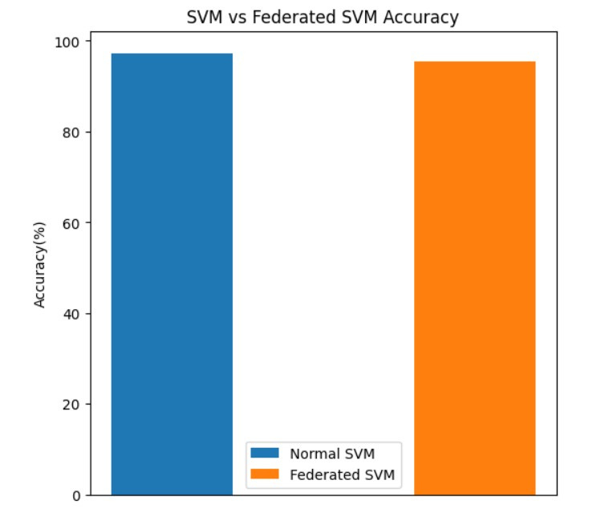
SVM vs
Federated
SVM
Accuracy

Slide 21
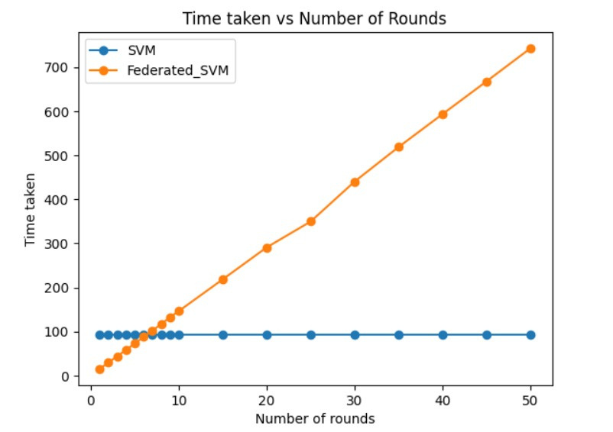
Computation
time plot
between
SVM and
FL SVM

Slide 22
Conclusion
The core aim of the algorithm is to evaluate the effectiveness of the federated algorithm, with a focus on privacy and security considerations.
This evaluation is carried out using a well-established dataset and the experimentation involves three distinct clients, each equipped with its unique dataset distribution.
An intriguing observation emerges when the model is tested exclusively on the local data of each client, the accuracy is notably lower.
Remarkably, the accuracy achieved through federated learning is more or equal to that obtained through conventional centralized training methods.

Slide 23
It’s not an end...

Slide 24
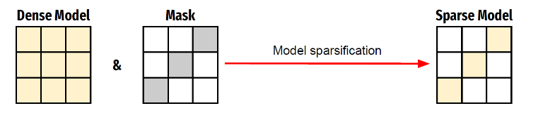
Sparsed Federated Learning
Transfer sparse models instead of dense models to reduce the communication cost in federated learning.
The proposed method in sparse FL Communication constructs a sparse model by selecting only parameters that have been updated significantly.
How it works? : We compute the absolute difference between the parameters of the local model before and after training, and exchange only the upper quantile of the updated parameters between the server and the clients.

Slide 25
Sparsed Federated Learning
This parameter-wise selection approach increases the opportunity to reduce communication costs since it omits unnecessary parameters and keeps the necessary parameters for the transfer.
Justification: It is reasonable not to transfer the parameters that do not have significant updates in the local model, since they may not have much impact on the global model update.
The tradeoff between the model accuracy and the communication cost is adjusted with a hyperparameter. This hyperparameter controls the level of sparsification, i.e. what fraction of the model is exchanged between the server and clients.

Slide 26
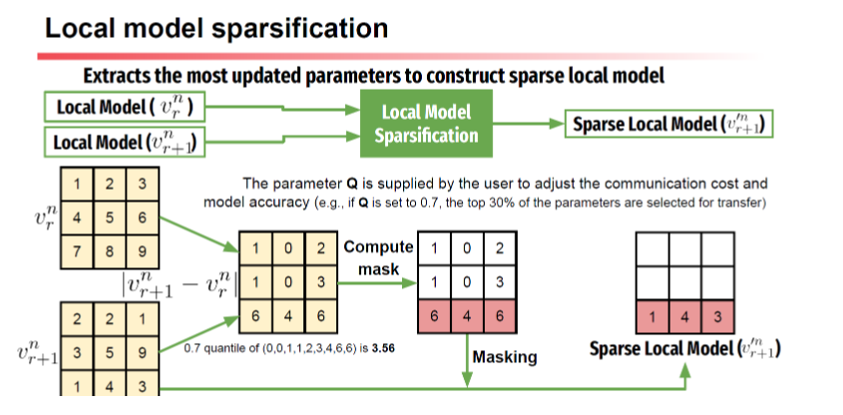

Slide 27
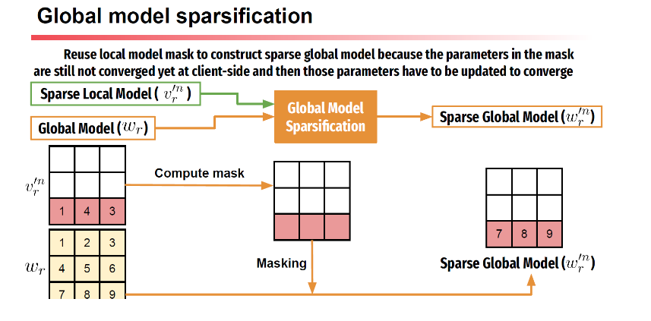

Slide 28
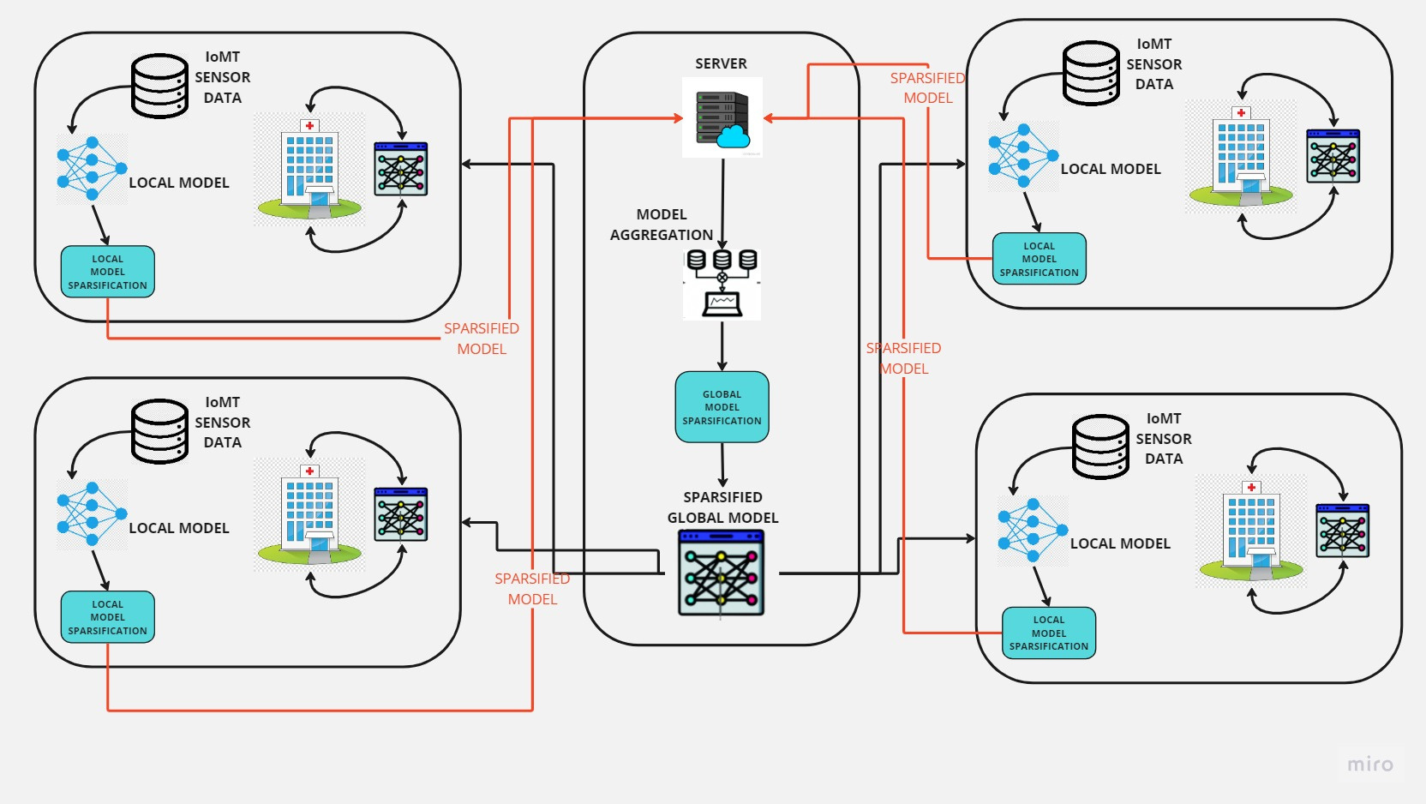
Sparsed Federated Learning in IoMt System Architecture?

Slide 29
Conclusion
A novel method to reduce the communication cost for federated learning by sparsifying local and global models.
The proposed method utilises exchanging the most updated parameters of neural network models.
One immediate benefit of sparse Federated Learning is smaller size, given we only need to keep the non-zero connections, which is a huge benefit when trying to fit the networks in edge devices.

Slide 30
Thank You

